Slide 1
Localization Technology

Slide 2
Outline
Defining location
Methods for determining location
Triangulation, trilateration, RSSI, etc.
Location Systems

Slide 3
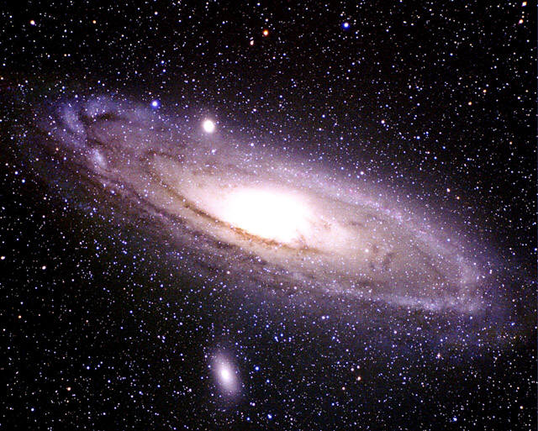
Introduction
We are here !

Slide 4
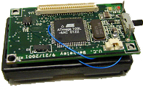
What is Localization
A mechanism for discovering spatial relationships between objects

Slide 5
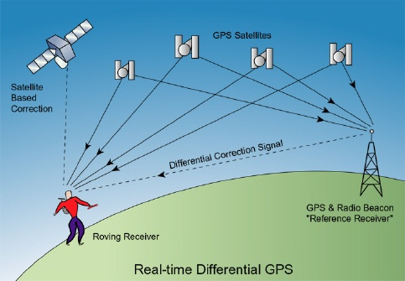
Location Tracking

Slide 6
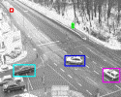
Applications
Wildlife Tracking
Weather Monitoring
Location-based Authentication
Routing in ad-hoc networks
Surveillances

Slide 7
Applications of Location Information
Location aware information services
e.g., E911, location-based search, target advertisement, tour guide, inventory management, traffic monitoring, disaster recovery, intrusion detection
Scientific applications
e.g., air/water quality monitoring, environmental studies, biodiversity
Military applications
Resource selection (server, printer, etc.)
Sensor networks
Geographic routing
“Sensing data without knowing the location is meaningless.” [IEEE Computer, Vol. 33, 2000]
New applications enabled by availability of locations

Slide 8
Localization
Well studied topic (3,000+ PhD theses??)
Application dependent
Research areas
Technology
Algorithms and data analysis
Visualization
Evaluation

Slide 9
Properties of Localization
Physical position versus symbolic location
Absolute versus relative coordinates
Localized versus centralized computation
Precision
Cost
Scale
Limitations

Slide 10
Representing Location Information
Absolute
Geographic coordinates (Lat: 33.98333, Long: -86.22444)
Relative
1 block north of the main building
Symbolic
High-level description
Home, bedroom, work

Slide 11
No One Size Fits All!
Accurate
Low-cost
Easy-to-deploy
Ubiquitous
Application needs determine technology

Slide 12
Consider for Example…
Motion capture
Car navigation system
Finding a lost object
Weather information
Printing a document

Slide 13
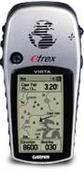
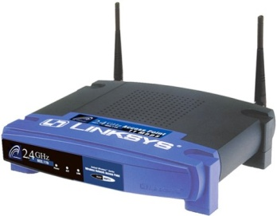

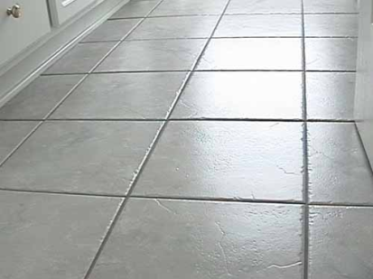
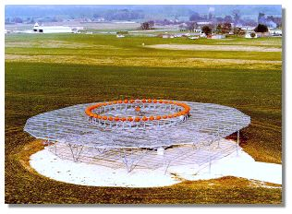
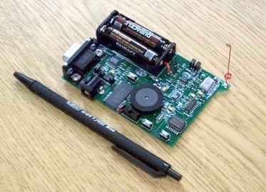
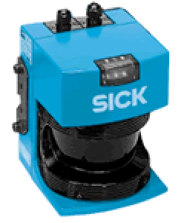
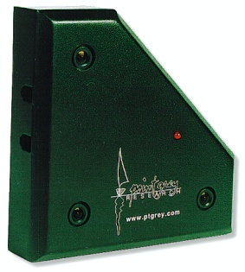
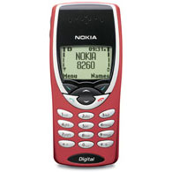
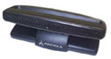
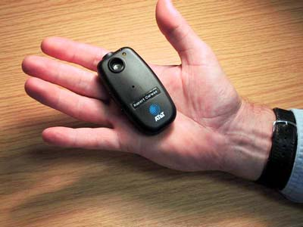
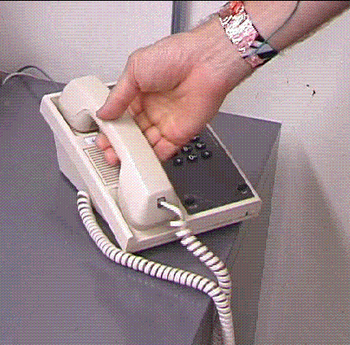
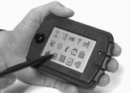
Lots of Technologies!
GPS
WiFi Beacons
Ultrasound
Floor pressure
Laser range-finding
VHF Omni Ranging
Ad hoc signal strength
Stereo camera
Array microphone
E-911
Ultrasonic time of flight
Infrared proximity
Physical contact

Slide 14
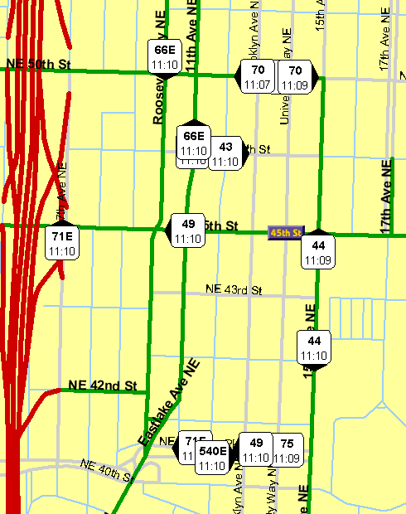
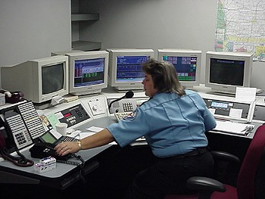
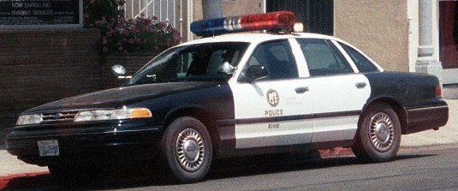
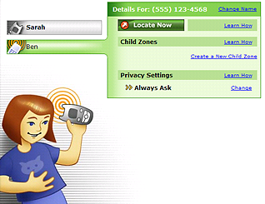
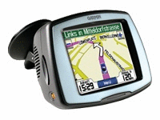
Some Outdoor Applications
E-911
Bus view
Child tracking
Car Navigation

Slide 15
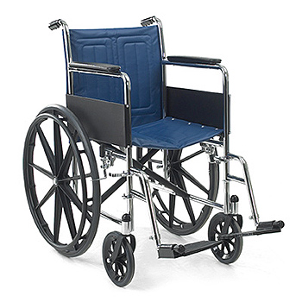
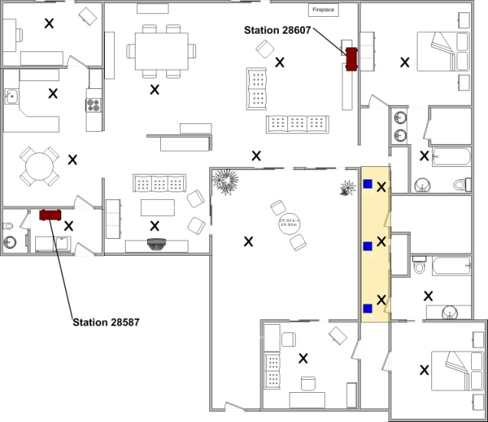

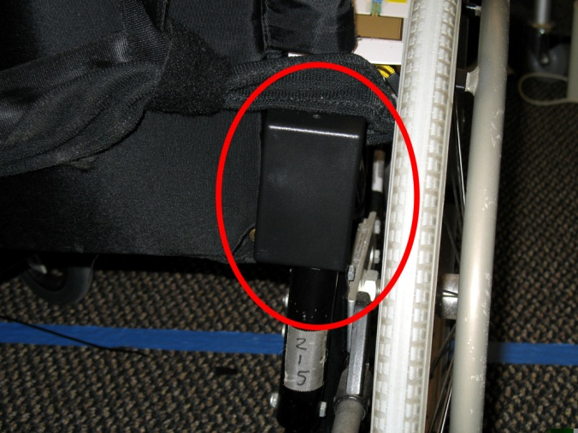
Some Indoor Applications
Elder care

Slide 16
Outline
Defining location
Methods for determining location
Triangulation, trilateration, RSSI, etc.
Location Systems

Slide 17
Approaches for Determining Location
Localization algorithms
Proximity
Lateration
Angulation
RSSI
ToA, TDoA
Fingerprinting
Distance estimates
Time of Flight
Signal Strength Attenuation

Slide 18
Proximity
Simplest positioning technique
Closeness to a reference point
It can be used to decide whether a node is in the proximity of an anchor
Based on loudness, physical contact, etc.
Can be used for positioning when several overlapping anchors are available
Centronoid localization

Slide 19
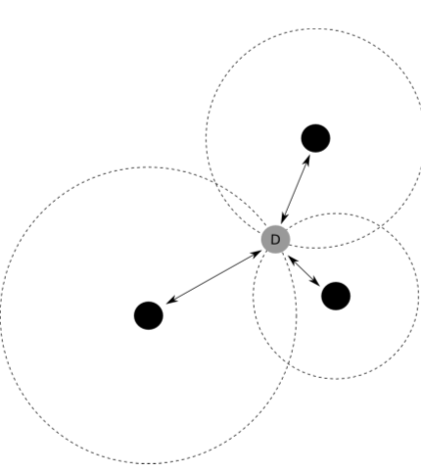
Lateration
Measure distance between device and reference points
3 reference points needed for 2D and 4 for 3D

Slide 20
Lateration vs. Angulation
When distances between entities are used, the approach is called lateration
when angles between nodes are used, one talks about angulation

Slide 21
Determining Angles
Directional antennas
On the node
Mechanically rotating or electrically “steerable”
On several access points
Rotating at different offsets
Time between beacons allows to compute angles

Slide 22
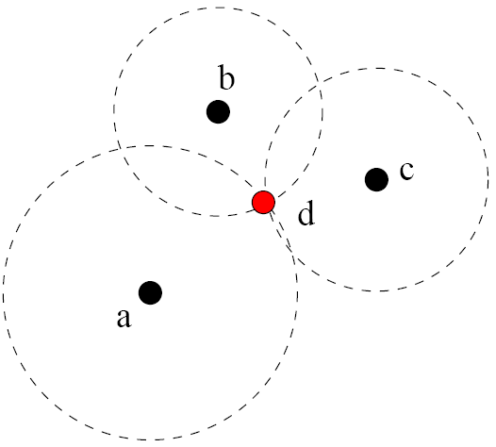
Triangulation, Trilateration
Anchors advertise their coordinates & transmit a reference signal
Other nodes use the reference signal to estimate distances anchor nodes

Slide 23
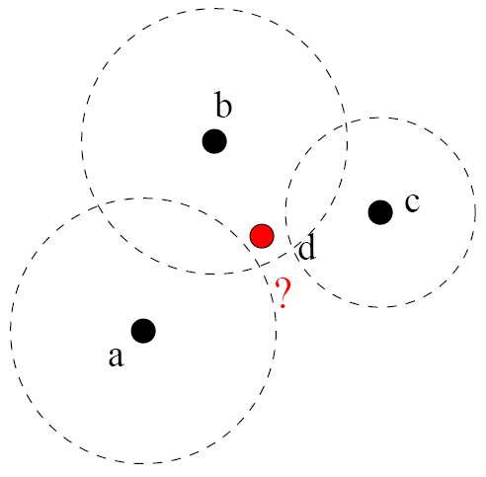
Optimization Problem
Distance measurements are noisy!
Solve an optimization problem: minimize the mean square error

Slide 24
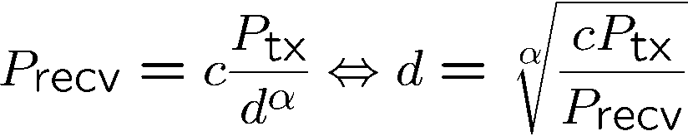
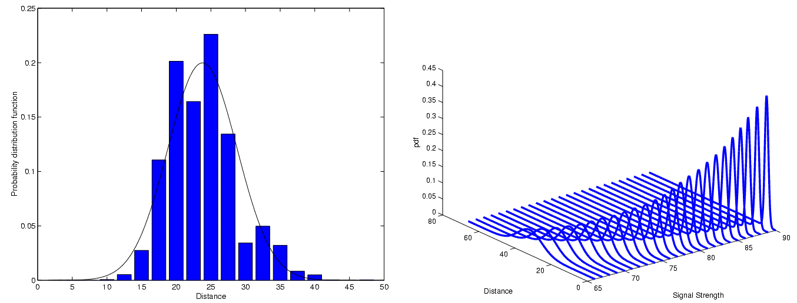
Estimating Distances – RSSI
Received Signal Strength Indicator
Send out signal of known strength, use received signal strength and path loss coefficient to estimate distance
Problem: Highly error-prone process (especially indoor)
Shown: PDF for a fixed RSSI
PDF
PDF
Distance
Distance
Signal strength

Slide 25
Estimating Distances – Other Means
Time of arrival (ToA)
Use time of transmission, propagation speed, time of arrival to compute distance
Problem: Exact time synchronization
Time Difference of Arrival (TDoA)
Use two different signals with different propagation speeds
Example: ultrasound and radio signal
Propagation time of radio negligible compared to ultrasound
Compute difference between arrival times to compute distance
Problem: Calibration, expensive/energy-intensive hardware

Slide 26
Fingerprinting
Mapping solution
Address problems with multipath
Better than modeling complex RF propagation pattern

Slide 27
Fingerprinting
SSID (Name) | BSSID (MAC address) | Signal Strength (RSSI)
linksys | 00:0F:66:2A:61:00 | 18
starbucks | 00:0F:C8:00:15:13 | 15
newark wifi | 00:06:25:98:7A:0C | 23

Slide 28
Fingerprinting
Easier than modeling
Requires a dense site survey
Usually better for symbolic localization
Spatial differentiability
Temporal stability

Slide 29
Received Signal Strength (RSS) Profiling Measurements
Construct a form of map of the signal strength behavior in the coverage area
The map is obtained:
Offline by a priori measurements
Online using sniffing devices deployed at known locations
They have been mainly used for location estimation in WLANs

Slide 30
Received Signal Strength (RSS) Profiling Measurements
Different nodes:
Anchor nodes
Non-anchor nodes,
A large number of sample points (e.g., sniffing devices)
At each sample point, a vector of signal strengths is obtained
jth entry corresponding to the jth anchor’s transmitted signal
The collection of all these vectors provides a map of the whole region
The collection constitutes the RSS model
It is unique with respect to the anchor locations and the environment
The model is stored in a central location
A non-anchor node can estimate its location using the RSS measurements from anchors

Slide 31
Outline
Defining location
Methods for determining location
Triangulation, trilateration, RSSI, etc.
Location Systems
GPS
Active Badge, MIL, Active Bat, Cricket
RSS-based indoor localization
RSS-based smartphone indoor localization
Power-line based localization
Passive location tracking

Slide 32
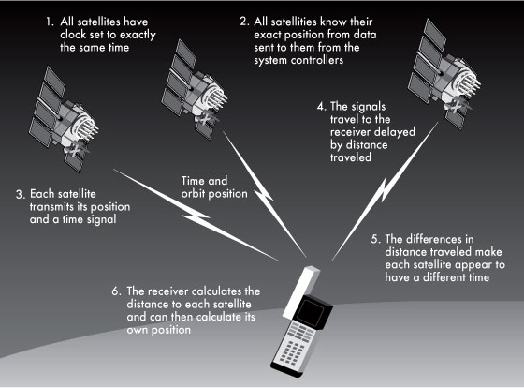
GPS (Global Position Systems)
Use 24 satellites
GPS satellites are essentially a set of wireless base stations in the sky
The satellites simultaneously broadcast beacon messages
A GPS receiver measures time of arrival to the satellites, and then uses “triangulation” to determine its position
Civilian GPS
L1 (1575 MHZ)
10 meter acc.

Slide 33
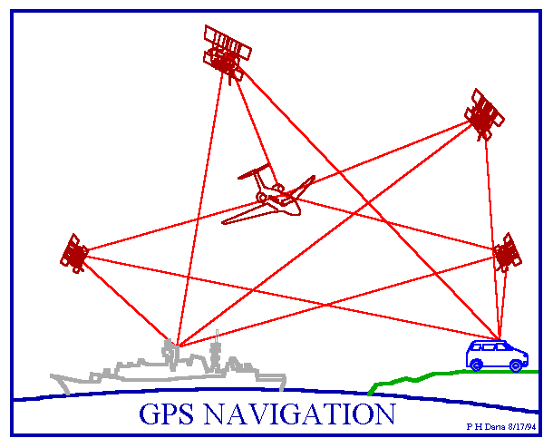
Why We Need 4 Satellites?
Assume receiver clock is sync’d with satellites
In reality, receiver clock is not sync’d
with satellites
Thus need one more satellite to have
the right number of equations to estimate
clock
called pseudo range

Slide 34
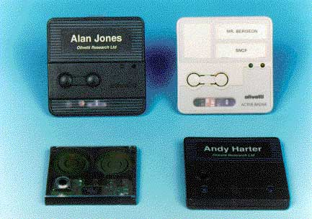
Active Badge
IR-based: every badge periodically, sends unique identifier, via infrared, to the receivers
Receivers, receive this identifiers and store it on a central server
Proximity

Slide 35
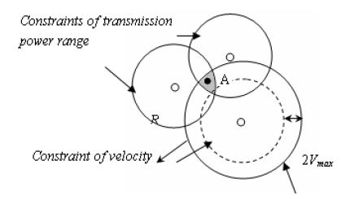
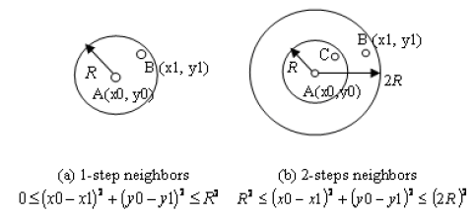
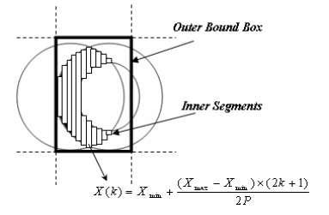
MIL (Mobile Inequality Localization)
Illustration for relative distance constraints
Static Constraint
Velocity Constraint
“Weighted center” based
position estimation

Slide 36
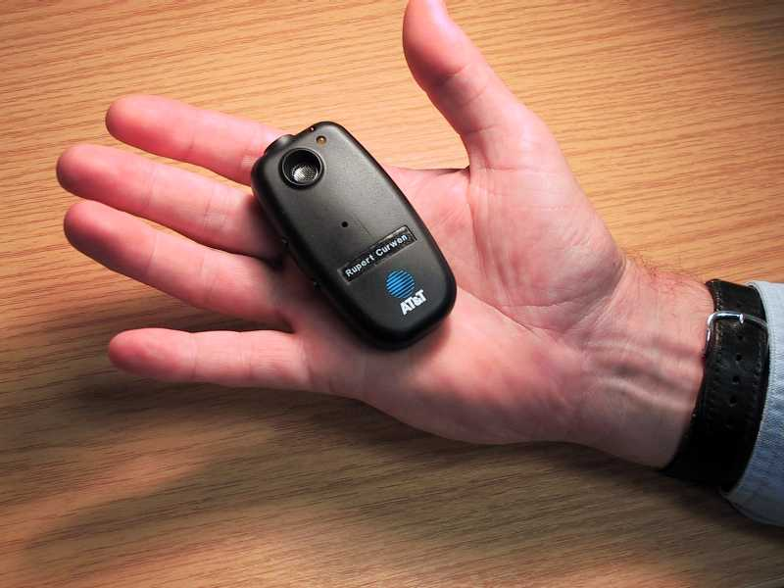
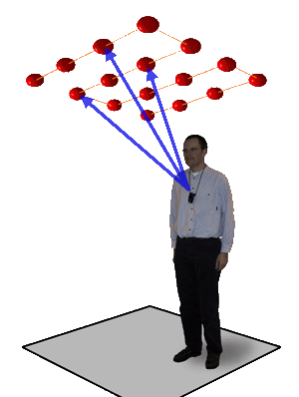
Active Bat
Ultrasonic
Time of flight of ultrasonic pings
3cm resolution

Slide 37
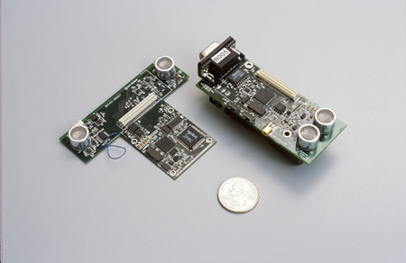
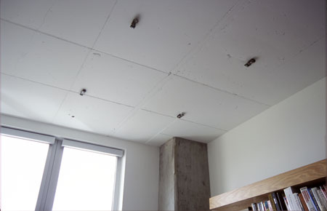
Cricket
Similar to Active Bat
Decentralized compared to Active Bat

Slide 38
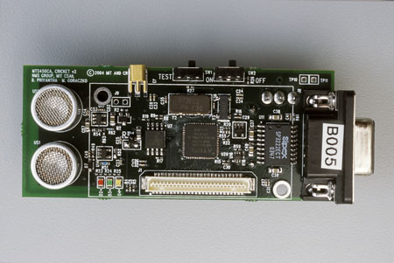
Cricket: Introduction
Location system
Project started in 2000 by the MIT
Other groups of researchers in private companies
Small, cheap, easy to use
Cricket node v2.0

Slide 39
Cricket: 5 Specific Goals
User privacy
location-support system, not location-tracking system
position known only by the user
Decentralized administration
easier for a scalable system
each space (e.g. a room) owned by a beacon
Network heterogeneity
need to decouple the system from other data communication protocols (e.g. Ethernet, WLAN)
Cost
less than U.S. $10 per node
Room-sized granularity
regions determined within one or two square feet

Slide 40
Cricket: Determination of the Distance
First version
purely RF-based system
problems due to RF propagation within buildings
Second version
combination of RF and ultrasound hardware
measure of the one-way propagation time of the ultrasonic signals emitted by a node
main idea : information about the space periodically broadcasted concurrently over RF, together with an ultrasonic pulse
speed of sound in air : about 340 m/s
speed of light : about 300 000 000 m/s

Slide 41
Cricket: Determination of the Distance
1. The first node sends a RF message and an ultrasonic pulse at the same time.
2. The second node receives the RF message first, at t_{RF} and activates its ultrasound receiver.
RF message (speed of light)
Node 1
Node 2
ultrasonic pulse (speed of sound)
3. A short instant later, called t_{ultrasonic}, it receives the ultrasonic pulse.
4. Finally, the distance can be obtained using t_{RF}, t_{ultrasonic}, and the speed of sound in air.

Slide 42
Cricket: Difficulties
Collisions
no implementation of a full-edged carrier-sense-style channel-access protocol to maintain simplicity and reduce overall energy consumption
use of a decentralized randomized transmission algorithm to minimize collisions
Physical layer
decoding algorithm to overcome the effects of ultrasound multipath and RF interferences
Tracking to improve accuracy
a least-squares minimization (LSQ)
an extended Kalman filter (EKF)
outlier rejection

Slide 43
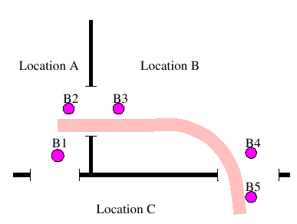
Cricket: Deployment
Common way to use it : nodes spread through the building (e.g. on walls or ceiling)
3D position known by each node
Node identification
unique MAC address
space identifier
Boundaries
real (e.g. wall separating 2 rooms)
virtual, non-physical (e.g. to
separate portions of a room)
Performance of the system
precision
granularity
accuracy

Slide 44
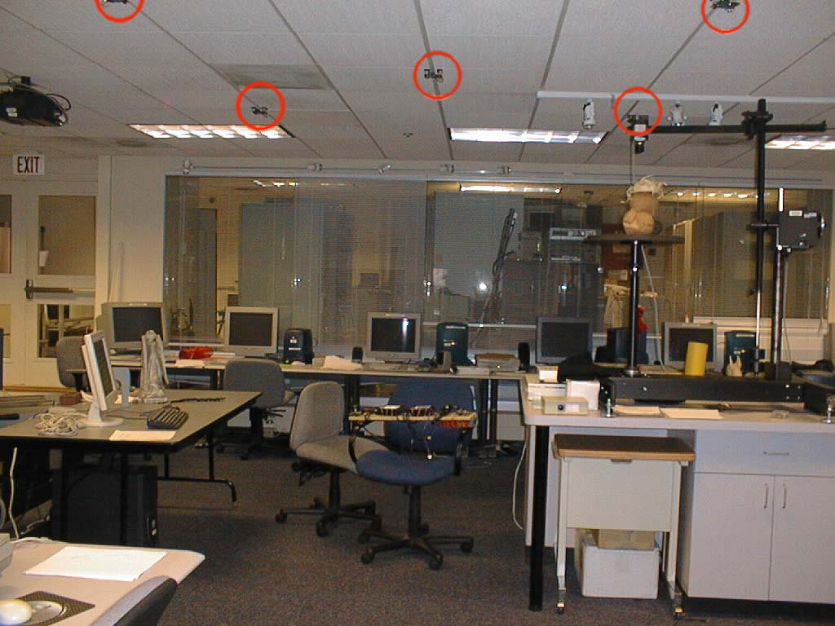
Cricket: Deployment
At the MIT lab : on the ceiling

Slide 45
Cricket: Different Roles
A Cricket device can have one of these roles
Beacon
small device attached to a geographic space
space identifier and position
periodically broadcast its position
Listener
attached to a portable device (e.g. laptop, PDA)
receives messages from the beacons and computes its position
Beacon and listener (symmetric Cricket-based system)

Slide 46
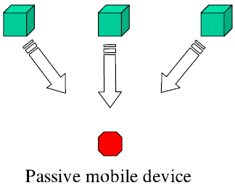
Cricket: Passive Mobile Architecture
In a passive mobile architecture, fixed nodes at known positions periodically transmit their location (or identity) on a wireless channel, and passive receivers on mobile devices listen to each beacon.

Slide 47
Cricket: Active Mobile Architecture
In an active mobile architecture, an active transmitter
on each mobile device periodically broadcasts a message on a wireless channel.

Slide 48
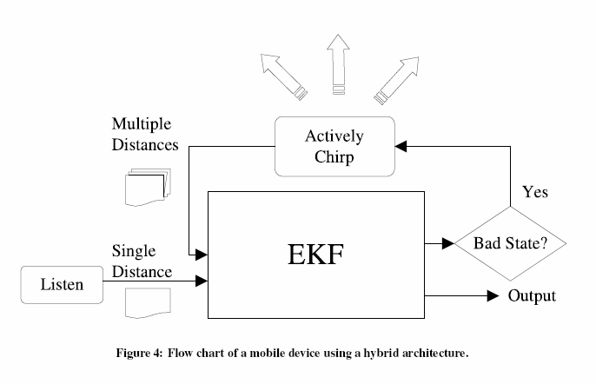
Cricket: Hybrid Mobile Architecture
Passive mobile system: used in normal operation
Active mobile system: at start-up or when bad Kalman filter state is detected

Slide 49
Cricket: Architecture
Cricket hardware unit – beacon or listener

Slide 50
Cricket: Architecture
Microcontroller
the Atmega 128L operating at 7.3728 Mhz in active and 32.768 kHz in sleep mode
operates at 3V and draws about 8mA(active mode) or 8μA(sleep mode)
RF transceiver
the CC1000 RF configured to operate at 433 Mhz
bandwidth bounded to 19.2 kilobits/s

Slide 51
Cricket: Architecture
Ultrasonic transmitter
40 kHz piezo-electric open-air ultrasonic transmitter
generates ultrasonic pulses of duration 125 μs
voltage multiplier module generates 12 V from the 3 V supply voltage to drive the ultrasonic transmitter
Ultrasonic receiver
open-air type piezo-electric sensor
output is connected to a two-stage amplifier with a programmable voltage gain between 70 dB and 78 dB

Slide 52
Cricket: Architecture
RS 232 interface
used to attach a host device to the Cricket node
Temperature sensor
allows to compensate for variations in the speed of sound with temperature
Unique ID
an 8-byte hardware ID, uniquely identifies every Cricket node
Powering the Beacons and Listeners
each Cricket node may be powered using two AA batteries, a power adapter, or solar cells
beacon can operate on two AA batteries for 5 to 6 weeks

Slide 53
Evaluation – Test of Cricket
The experimental setup and schematic representation of the train's trajectory

Slide 54
Evaluation – Test of Cricket
Experimental facts
Three architectures: passive mobile, active mobile, and hybrid with Extended Kalman Filter (EKF) or least-squares minimization (LSQ)
Computer-controlled Lego train set running at six different speeds: 0.34 m/s, 0.56 m/s, 0.78 m/s, 0.98 m/s, 1.21 m/s, and 1.43 m/s
Multiple beacons (five or six in all experiments) interacting with one another
Gathered about 15,000 individual distance estimates in the active mobile architecture and about 3,000 distance estimates in the passive mobile architecture

Slide 55
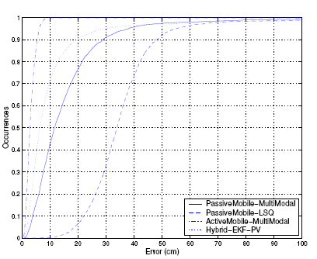
Evaluation – Test of Cricket
Accuracy
For speed of 0.78m/s For speed of 1.43m/s
Passive mobile architecture (EKF)
– median error is about 10cm
Passive mobile architecture (LSQ)
– 30th percentile error is less than 30cm
Active mobile architecture
– median error is about 3cm
Hybrid mobile architecture
– median error is about 7cm
Passive mobile architecture(EKF)
– median error is about 23cm
Passive mobile architecture(LSQ)
– only 30th percentile error is less than 50cm
Active mobile architecture
– median error is about 4cm
Hybrid mobile architecture
– median error is about 15cm

Slide 56
Evaluation – Test of Cricket
Linear relationship between speed and accuracy

Slide 57
Cricket: Summary
Advantages
Disadvantages
Passive Mobile Architecture
privacy
scalability
acceptable accuracy at small speed
weak accuracy at higher speed(above 1m/s)
decentralization
Active Mobile Architecture
accuracy
reduced scalability
privacy concern
requires a network
infrastructure
Hybrid Mobile Architecture
privacy(usage of active mobile information is less than 2%)
scalability
accuracy
decentralization

Slide 58
Outline
Defining location
Methods for determining location
Triangulation, trilateration, RSSI, etc.
Location Systems
GPS
Active Badge, MIL, Active Bat, Cricket
RSS-based indoor localization
RSS-based smartphone indoor localization
Power-line based localization
Passive location tracking

Slide 59


RSS-based Indoor Localization
Radio Frequency Identification (RFID)
LANDMARC [INFOCOM’04], Wang et al. [INFOCOM’07], Seco et al. [IPIN’10]
Ficsher et al.[CWPNC’04], PlaceLab [Pervasive’04], Pei et al. [JGPS’10]
Bluetooth
Wireless Sensor
Chang et la. [Sensys’08], Chung et al. [MobiSys’11], Pirkl et al. [UbiComp’12 ]
GSM
Otsason et al. [UbiCom’05]
Wireless Local Area Network (WLAN)
RADAR [INFOCOM’00], Horus [MobiSys’05], Chen et al.[Percom’08]
Notes:
Existing RSS-based Indoor Localization Techniques including RFID, Bluetooth, Wireless sensors, GSM and WLAN.

Slide 60
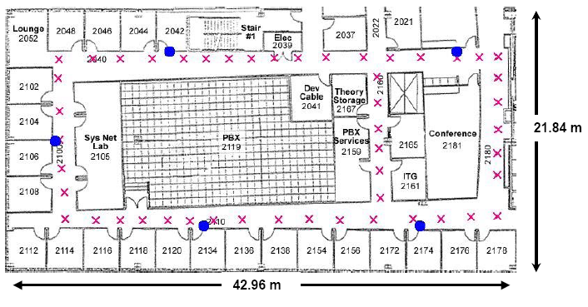
RADAR
An In-building RF-based user location and tracking system
WiFi-based localization
Reduce need for new infrastructure
Fingerprinting, RSSI profiling

Slide 61
RADAR
Uses RF signal strength (SS) from multiple receiver locations to triangulate the user’s coordinates.
Can be used for location aware applications.
Detect nearest printer
Authors examine empirical and RF model technique

Slide 62
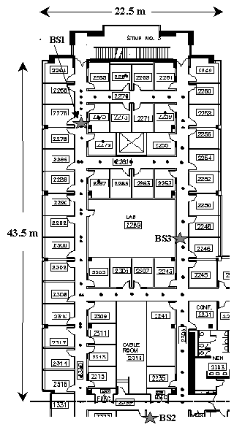
Test Environment
3 Base Stations
10500 sq ft
Lucent WaveLAN cards.
200m/50m/25m range for open/semi-open/closed areas.
Map of Testbed

Slide 63
Empirical Data Collection
Mobile host 4 UDP packets per second with 6-byte payload.
Each base station records the signal strength with timestamp (t, bs, ss)
User indicates current location on mobile application
Store orientation since it causes variation in detected signal.
Mobile node records (t, x, y, d)
Data collection phase repeated for 70 distinct locations for 4-directions.

Slide 64
Generate Signal Information
Merge Data
Merge data from 3 base stations and mobile node.
Generate tuple (x, y, d, ss(i), snr(i)) where i is the base station ID.
Determine closest matches.
Use multi-dimensional search algorithm to compare off-line and on-line data. Calculate building layout
Cohen-Sutherland line-clipping algorithm to compute the number of walls that obstructed direct line of sight base stations and locations.

Slide 65
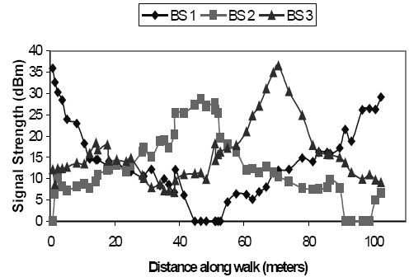
Analysis
Convert physical space to signal space (ss1,ss2,ss3)
Nearest Neighbor in Signal Space (NNSS) using Euclidean distance.

Slide 66
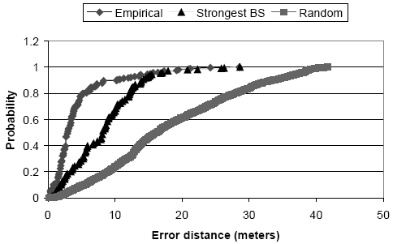
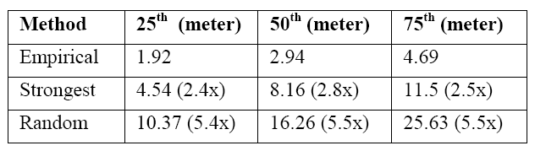
Comparison
Empirical Method is more accurate than other tracking methods.

Slide 67

K-nearest Neighbors
Average k neighbors (in signal space)
Result: Small k has some benefit and large k is not accurate.
K-neighbors in signal space are not near in physical space.
An illustration of how averaging multiple nearest (N1, N2, N3) can lead to a guess (G) that is closer to the user’s true location (T) than any of the neighbors is individually.

Slide 68

Max Signal Strength Across Orientations
Combine highest SS of 4 orientations.
Final tuple may contain SS for different orientations.
Simulate case where SS is not obstructed by the human body.
Decrease data size to 70 instead of 70*4.
Reduced Dataset with k-neighbors.

Slide 69
Other Analysis Methods
Accuracy did not decrease with number or data points.
Accuracy decreased with decreased samples.
Ignoring radio orientation decreases accuracy
Tracking Mobile User as sequence of location determination problems.
Use 10 sample window. Results are only slightly worse.

Slide 70

Radio Propagation Model
Use mathematical model for indoor RF propagation to directly calculate users position.
Empirical method is accurate but depends on accurate training data.
Based on Multipath Fading Models
Transmitted signal reaches the receiver via multiple paths.
Rayleigh fading, Rician distribution, Attenuation Factor
Wall attenuation factor
Accommodate loss due to building. Empirically determined attenuation caused by wall.
Wall Attenuation Factor Formula

Slide 71

Empirical vs. RF Model
Actual SS fluctuates more than RF model
RF Model can track objects to within 4 to 8 meters
Predicted SS vs Actual SS

Slide 72
Conclusions
Authors show WIFI can be used to track objects.
Empirical Method can track objects within 2-3 meters.
RF Model Method can track objects within 4-8 meters.

Slide 73
LANDMARC Indoor Location Sensing Using Active RFID

Slide 74

RFID Technology
It is a means of storing and retrieving data through electromagnetic transmission to an RF compatible integrated circuit.
Components Of RFID System
RFID readers
RFID Tags

Slide 75
Active RFID Tag
Active RFID tags are powered by an internal battery and are typically read/write.
An active tag’s memory size varies according to application requirements; some systems operate with up to 1MB of memory.
The battery-supplied power of an active tag generally gives it a longer read range.

Slide 76
RFID Applications
Security access, Asset tracking, and Animal identification applications
Railroad Car Tracking and Automated Toll Collection

Slide 77
Approach
Increase accuracy without placing more readers.
Employs idea of having extra fixed location reference tags to help location calibration.

Slide 78
Advantages
No need for large number of expensive RFID readers.
Environmental dynamics can easily be accommodated.
Location information more reliable and accurate.

Slide 79
Issues
Current RFID system does not provide the signal strength of tags directly to readers.
Power level distribution is dynamic in a complicated indoor environment.

Slide 80
System Setup
Prototype environment consists of a sensing network [ RF readers and RF tags ] and a wireless network that enables the communication between mobile devices and the internet.
Also consists of a Tag Tracker Concentrator LI
[ API provided by RF Code ] which acts a central configuration interface for RF readers.

Slide 81
Methodology
We have ‘n’ RF readers along with ‘m’ tags as reference tags and ‘u’ tracking tags as objects being tracked.
Readers configured with continuous mode and detection range of 1-8 which cycle at a rate of 30secs per range.

Slide 82
Definitions
Signal Strength Vector of a tracking/moving tag is given as S=(S_{1,} S_{2,…,} S_{n}) , where Si denotes the signal strength of the tracking tag perceived on reader i, where i € ( 1,n ).
For the reference tags, we denote the corresponding Signal Strength vector as
θ =(θ₁, θ₂,…, θ_{n}) where θ_{i} denotes the signal strength.

Slide 83

Definitions [ Continued ]
Euclidian distance in signal strengths between a tracking tag and a reference tag .
For each individual tracking tag p where p € (1,u) we define:
where j € (1,m)

Slide 84
Definitions [ Continued ]
Let E denote the location relationship between the reference tags and the tracking tag i.e. the nearer reference tag to the tracking tag is supposed to have a smaller E value.
A tracking tag has the vector È= (E₁,E₂,..,E_{n}).

Slide 85
Issues in Locating the unknown Tag
Placement of reference tags.
Number of reference tags in a reference cell.
Determine the weights associated with different neighbors.

Slide 86

Formulae
The unknown tracking tag coordinate (x, y) is obtained by:
where wi is the weighting factor to the i-th neighboring reference tag.

Slide 87

Formulae [Continued]
wi is a function of the E values of k-nearest neighbors. Empirically, in LANDMARC, weight is given by:

Slide 88

Experimental Results
Standard Setup:
We place 4 RF readers (n=4) in our lab and 16 tags (m=16) as reference tags while the other 8 tags (u=8) as objects being tracked.

Slide 89

Basis For Accuracy
To quantify how well the LANDMARC system performs, the error distance is used as the basis for the accuracy of the system. We define the location estimation error, e, to be the linear distance between the tracking tag’s real coordinates (x₀,y₀) and the computed coordinates (x,y) given by :

Slide 90

Placement Configuration

Slide 91

Effect of the Number of Nearest Neighbors

Slide 92

Influence of the Environmental Factors

Slide 93

Comparison between the Two Placement Configurations

Slide 94

Effect of the Number Of Readers

Slide 95

Effect Of Placement Of Reference Tags

Slide 96

Possible Solution

Slide 97

Setup for Higher Density Placements of Reference Tags

Slide 98

Results for Higher Reference Tag density

Slide 99

Setup for Lower Density Placements of Reference Tags

Slide 100

Results for Low Reference Tag Density

Slide 101
Conclusion
Using 4 RF readers in the lab, with one reference tag per square meter, it can accurately locate the objects within error distance such that the largest error is 2 meters and the average is about 1 meter.

Slide 102
Outline
Defining location
Methods for determining location
Triangulation, trilateration, RSSI, etc.
Location Systems
GPS
Active Badge, MIL, Active Bat, Cricket
RSS-based indoor localization
RSS-based smartphone indoor localization
Power-line based localization
Passive location tracking

Slide 103
RSS-based Smartphone Indoor Localization
WiFi enabled
Chintalapudi et al. [MobiCom’10], OIL [MobiSys’10], WiGEM [CoNexts’11]
Improve WiFi accuracy
Hybrid
Zee[MobiCom’12], UnLoc[MobiSys’12], WILL[INFOCOM’12], LiFS[MobiCom’12], ABS[MobiSys’11], Liu et al.[MobiCom’12], SurroundSense [MobiCom’09], Escort [MobiCom’10]
Notes:
Contemporary ..can be categorized into 2 folds: wifi enabled, to further improve wifi accuracy, hybrid approaches are emerging. By leveraging other built-in techniques on smartphones.
Basic idea:
Modeling: new algorithm
Fingerprinting: matching algorithm

Slide 104

RSS-based Smartphone Indoor Localization
Hybrid Approach (WiFi + Inertial Sensors)
User Motion Information
[MobiCom’12] Zee: Zero-Effort Crowdsourcing for Indoor Localization
Notes:
Zero-effort:
[MobiCom’12] Zee: Zero-Effort Crowdsourcing for Indoor Localization
The only site-specific input: a map showing the pathways (e.g., hallways) and barriers (e.g., walls)
[MobiCom’12] Push the Limit of WiFi based Localization for Smartphones
[MobiCom’12] Locating in Fingerprint Space- Wireless Indoor Localization with Little Human Intervention

Slide 105


WiFi Based Localization
Step 1: Site survey
To obtain training data <location, RSS>
Usually a manual process by specialist
Step 2: Offline training phase
Mapping: location → RSS
Step 2: Online location inference
Inverse mapping: RSS → Location
⬅ Often key bottleneck

Slide 106
Basic Idea
Tackle the task via crowdsourcing
Leverage normal user walking and mobile sensors
Personalized inertial tracking and background WiFi data collection
Requirement: No user inputs

Slide 107



Problem and Solution
Problem: to get the location of each WiFi scan.
Solution: personalized inertial tracking
Use WiFi card to scan and obtain measurements simultaneously
Use motion vectors to track the users’ location as they walk
Stride
Length
Distance
Step
Accel
Motion
Vector
Compass
Direction of Motion

Slide 108
Challenges
Unknown initial location
No input from user, nor intermediate checkpoints
Unknown stride length
No user specific pre-calibration
Unknown phone placement
In hand, pant pocket, etc.
Compass heading errors
Personalized inertial tracking

Slide 109


































































































































Challenge: unknown initial location
No input from user, no intermediate checkpoints
A
B
C
35m
D
65m

Slide 110







































Solution: belief back propagation
Trace the probability distribution backwards in time
35m
65m

Slide 111


Challenge: heading offset estimation
Walking direction ≠ Compass Direction
Real Heading = Compass Measurement (θ) + Placement Offset (α) (Constant) + Magnetic Offset (γ) (Var, Gaussian)
Estimating placement offset
Key Observation: Second harmonic is absent in acceleration perpendicular to walking direction

Slide 112



System Performance

Slide 113









RSS-based Smartphone Indoor Localization
Hybrid Approach (WiFi + Acoustic)
Physical Constraints
Peer 1
Peer 2
Peer 3
Target
Provide physical constraints from nearby peer phones
[MobiCom’12] Push the Limit of WiFi based Localization for Smartphones

Slide 114





Root Cause of Large Localization Errors
Am I here?
Received Signal Strenth (dBm)
~ 2 meters
I am around here.
6 - 8 meters
WiFi as-is is not a suitable candidate for high accurate localization due to large errors
Is it possible to address this fundamental limit without the need of additional hardware or infrastructure?
32: [ -22dB, -36dB, -29dB, -43dB ]
48: [ -24dB, -35dB, -27dB, -40dB]
Permanent environmental settings, such as furniture placement and walls.
Transient factors, such as dynamic obstacles and interference.
Physically distant locations share similar WiFi Received Signal Strength !
Orientation, holding position, time of day, number of samples

Slide 115
Inspiration from Abundant Peer Phones in Public Place
Increasing density of smartphones in public spaces
Peer 1
Peer 2
How to capture the physical constraints?
Provide physical constraints from nearby peer phones
Target
Peer 3

Slide 116






Basic Idea
Peer 2
Peer 1
Peer 3
Target
Exploit acoustic signal/ranging to construct peer constraints
Interpolated Received Signal Strength Fingerprint Map
WiFi Position Estimation
Acoustic Ranging
116

Slide 117

System Design Goals and Challenges
Peer assisted localization
Fast and concurrent acoustic ranging of multiple phones
Ease of use
Exactly what is the algorithm to search for the best fit position and quantify the signal similarity so that to reduce large errors?
How to design and detect acoustic signals?
Need to complete in short time.
Not annoy or distract users from their regular activities.

Slide 118

RSS-based Smartphone Indoor Localization
Hybrid Approach
Logical Map + Real Map Mapping
Inertial sensors
[MobiCom’12]LiFS: Locating in Fingerprint Space
Notes:
We design LiFS, an indoor localization system based on off-the-shelf WiFi infrastructure and mobile phones.
By exploiting user motions from mobile phones, we successfully remove the site survey process of traditional approaches.
Real experiment results show that LiFS achieves comparable location accuracy to previous approaches even without site survey.
(1) transforming floor plan to stress-free floor plan; (The geographical distance between two locations in a floor plan is not necessary to be the walking distance between them due to the block of walls and other obstacles. Hence, we propose stress-free floor plan, which puts real locations in a floor plan into a high dimension space by MDS [4], such that the geometrical distances between the points in the high dimension space reflect their real walking distances. Through stress-free floor plan,
the walking distances collected by users can be accurately and carefully utilized.)
(2) creating fingerprint space;
(3) mapping fingerprints to real locations. (fingerprints are labeled with locations)
No need to site survey.
No extra infrastructure or hardware.
Independence from AP or GPS information.
Free of erroneous dead-reckoning.
No explicit participations on users.

Slide 119

Fingerprinting-based Techniques
Two stages: Training and Operating

Slide 120

Site Survey
Drawbacks:
Time-consuming and labor-intensive
Vulnerable to environmental dynamics
Limiting the availability of indoor localization and navigation services like Google Maps 6.0

Slide 121

Basic Ideas
User movements, i.e., moving paths, indicate the geographically connections between separated RSS fingerprints.
User moving paths in a building

Slide 122



Basic Ideas
Connected fingerprints form a high dimension fingerprint space, in which the distances among fingerprints, measured by user mobility, are preserved.
Reform the floor plan to the stress-free floor plan, a high dimension space in which the distance between two locations reflects their walking distances.

Slide 123
System Architecture
Inertial sensors
Notes:
We design LiFS, an indoor localization system based on off-the-shelf WiFi infrastructure and mobile phones.
By exploiting user motions from mobile phones, we successfully remove the site survey process of traditional approaches.
Real experiment results show that LiFS achieves comparable location accuracy to previous approaches even without site survey.
(1) transforming floor plan to stress-free floor plan; (The geographical distance between two locations in a floor plan is not necessary to be the walking distance between them due to the block of walls and other obstacles. Hence, we propose stress-free floor plan, which puts real locations in a floor plan into a high dimension space by MDS [4], such that the geometrical distances between the points in the high dimension space reflect their real walking distances. Through stress-free floor plan,
the walking distances collected by users can be accurately and carefully utilized.)
(2) creating fingerprint space;
(3) mapping fingerprints to real locations. (fingerprints are labeled with locations)
No need to site survey.
No extra infrastructure or hardware.
Independence from AP or GPS information.
Free of erroneous dead-reckoning.
No explicit participations on users.

Slide 124
SurroundSense:
Mobile Phone Localization via Ambience Fingerprinting

Slide 125
Context
Pervasive wireless connectivity
+
Localization technology
=
Location-based applications
Notes:
Let me begin by presenting the context in which this work is situated. In the last few years, the rapid growth of wireless Internet access, coupled with mobile device localization, has enabled a wealth of applications that revolve around the user’s location. These applications usually track a user’s location and based on this position provide a certain service to the user. For these reason this applications are called location-based applications.

Slide 126
Location-Based Applications (LBAs)
For Example:
GeoLife shows grocery list when near Walmart
MicroBlog queries users at a museum
Location-based ad: Phone gets coupon at Starbucks
iPhone AppStore: 3000 LBAs, Android: 500 LBAs
Notes:
126
Examples include GeoLife Features 500 LBAs

Slide 127
Most emerging location based apps
do not care about the physical location
GPS: Latitude, Longitude
Notes:
Well, as I have exemplified before, applications care more about the place of the user than the physical coordinates at which he might be.
That is they care whether the user is in a Starbucks ….. and not about knowing the latitude and longitude numbers.
This is because knowing the symbolic location of the user, LBAs have the opportunity to provide personalized service.
We call knowing the user’s place logical localization.

Slide 128
GPS: Latitude, Longitude
Starbucks, RadioShack, Museum, Library
Most emerging location based apps
do not care about the physical location
Instead, they need the user’s logical location
Notes:
Well, as I have exemplified before, applications care more about the place of the user than the physical coordinates at which he might be.
That is they care whether the user is in a Starbucks ….. and not about knowing the latitude and longitude numbers.
This is because knowing the symbolic location of the user, LBAs have the opportunity to provide personalized service.
We call knowing the user’s place logical localization.
128

Slide 129
Physical vs. Logical
Unfortunately, most existing solutions are physical
GPS
GSM based
SkyHook
Google Latitude
RADAR
Cricket
…
Notes:
129
Examples include GeoLife Features 500 LBAs

Slide 130
Given this rich literature,
Why not convert from
Physical to Logical Locations?

Slide 131

Physical Location
Error
Notes:
And Unfortunately several meters of error is too much for accurate logical localization …
Let me argue this through an illustration …

Slide 132
Starbucks
Pizza Hut
Physical Location
Error
Notes:
We call this the dividing wall problem and argue that because of this problem converting form physical to logical localization is error prone
Observe that localization based on WiFi signals is not sufficient, because WiFi signals pass through walls and they are overheard in both locations.
This is also why WiFi doesn’t work …

Slide 133
Starbucks
Pizza Hut
Physical Location
Error
The dividing-wall problem
Notes:
We call this the dividing wall problem and argue that because of this problem converting form physical to logical localization is error prone
Observe that localization based on WiFi signals is not sufficient, because WiFi signals pass through walls and they are overheard in both locations.
This is also why WiFi doesn’t work …
133

Slide 134
SurroundSense:
A Logical Localization Solution

Slide 135
Hypothesis
It is possible to localize phones by
sensing the ambience
such as sound, light, color, movement, WiFi …
Notes:
The hypothesis behind SurroundSense is that it’s possible to localize mobile phones based on ambience sensing.
By ambience we refer to sound, light, color, movement and WiFi.
Consider these three pictures form adjacent shops.
The bookstore to the left is well lit, the clothing shop in the middle is darker while the sports bar in the right is the darkest of the three.
Furthermore, looking at the floor colors we see that the bookstore is covered with green carpet, while the clothing shop has a grey carpet and the sports bar is covered with black wood floor.
In terms of sound the bookstore will be quiet, the clothing shop may play some music in the background, while the sports bar will include humans chatting and fans cheering.
Furthermore, the layout of a store and the nature of the business will force people to walk in different patterns. In the bookstore people will have a relaxed stroll interrupted by long standing periods while browsing through a book. In the clothing store the pace will be faster --with people moving from isle to isle-- while the standing periods will be smaller while checking some garment. Lastly, in the sports bar, people will be mostly static seating at the bar or at a table.
Lastly we can think also that the overheard access points in these locations are different for each location.
All these ambience information can be sensed through the mobile phone sensors, the microphone, the camera, the accelerometer and the WiFi card.

Slide 136



Hypothesis
It is possible to localize phones by
sensing the ambience
such as sound, light, color, movement, WiFi …
Notes:
136
The hypothesis behind SurroundSense is that it’s possible to localize mobile phones based on ambience sensing.
By ambience we refer to sound, light, color, movement and WiFi.
Consider these three pictures form adjacent shops.
The bookstore to the left is well lit, the clothing shop in the middle is darker while the sports bar in the right is the darkest of the three.
Furthermore, looking at the floor colors we see that the bookstore is covered with green carpet, while the clothing shop has a grey carpet and the sports bar is covered with black wood floor.
In terms of sound the bookstore will be quiet, the clothing shop may play some music in the background, while the sports bar will include humans chatting and fans cheering.
Furthermore, the layout of a store and the nature of the business will force people to walk in different patterns. In the bookstore people will have a relaxed stroll interrupted by long standing periods while browsing through a book. In the clothing store the pace will be faster --with people moving from isle to isle-- while the standing periods will be smaller while checking some garment. Lastly, in the sports bar, people will be mostly static seating at the bar or at a table.
Lastly we can think also that the overheard access points in these locations are different for each location.
All these ambience information can be sensed through the mobile phone sensors, the microphone, the camera, the accelerometer and the WiFi card.

Slide 137

Multi-dimensional sensing extracts more
ambient information
Any one dimension may not be unique,
but put together, they may provide a
unique fingerprint
Notes:
Based on our empirical observations we reached 2 conclusions
1.
2. Even if each dimension may not be unique, by putting them together we can get a unique fingerprint for each location.

Slide 138







SurroundSense
Multi-dimensional fingerprint
Based on ambient sound/light/color/movement/WiFi
Starbucks
Pizza Hut
Wall
Notes:
Fluorescent light … however by the nature of this locations we can imagine that Starbucks has some coffee grinding machines noises while RadioShack may have some loud music in the background

Slide 139

Should Ambiences be Unique Worldwide?
J
I
P
H
A
Q
K
C
B
D
E
Q
L
M
N
R
F
O
G
Notes:
The next question is does surrounsense require ambiences to be unique worldwide.
That is do we require that each individual shop has a unique ambience that can be distinguishable from any other location.

Slide 140
Should Ambiences be Unique Worldwide?
GSM provides macro location (strip mall)
SurroundSense refines to Starbucks
J
I
P
H
A
Q
K
C
B
D
E
Q
L
M
N
R
F
O
G
Notes:
Well, no, Surroundsense has a much weaker constraint.
We require the ambiences be different in a small region around a rough estimate of the phone location obtained through GSM localization.
The phone localizes itself using GSM, shortlists all the shops within the GSM localization error, these shops become the candidate shops and SS tries to localize the phone within one of these shops.
In other words, GSM will provide a macro location such as a strip mall, while SurroundSense will refine the location to a certain shop within the candidate shops.

Slide 141
Why does it work?
Economics forces nearby businesses to be diverse
Not profitable to have 3 adjascent coffee shops
with same lighting, music, color, layout, etc.
SurroundSense exploits this ambience diversity
The Intuition:
Notes:
141

Slide 142




SurroundSense Architecture
Matching
Ambience Fingerprinting
Sound
Test Fingerprint
Color/Light
+
Acc.
=
WiFi
Fingerprint
Database
Logical
Location
GSM Macro
Location
Candidate Fingerprints

Slide 143



Fingerprints
Acoustic fingerprint
(amplitude distribution)
0.14
0.12
0.1
0.08
0.06
0.04
0.02
0
Sound:
(via phone
microphone)
Color:
(via phone
camera)
Normalized Count
-1 -0.8 -0.6 -0.4 -0.2 0 0.2 0.4 0.6 0.8 1
Amplitude Values
Color and light fingerprints on HSL space
1
0.5
0
Lightness
0
1
0.5
0.6
0.8
0.2
0.4
Hue
1
0
Saturation
Notes:
We’ve extracted sound features based on sound amplitude values and their distribution. Here we plot the distribution of the sound amplitude for three adjacent locations: a Laundromat, a Pizza place Jimmy Jones and a coffee shop Bean Traders.
For color we use pictures of the floor. The intuition behind this choice is that colors in adjacent location are different. How do we know if a picture is of the floor. Well we can infer when the phone is facing done based on the accelerometer reading. If the phone is facing done we snap a photo. Even if we might catch shoes and the lower ends of trousers the largest part of the picture is going to cover the floor. We transfer the floor pictures to the HSL space and run simple color clustering algorithms to extract the dominant colors. Based on this information we build the color fingerprint.
Colors keep changing products get sold/removed …
Floor colors different from next shop
Long lived

Slide 144



Fingerprints
Movement: (via phone accelerometer)
Cafeteria
Clothes Store
Grocery Store
Moving
Static
Notes:
Now for movement we build the fingerprints based on the accelerometer readings. These graphs represent the user movement fingerprints in three locations. We extract two states: either the user is static or moving. These states are represented on the Y axis while on the X axis we have time. Why do they look different? Well let’s look at each individual shop and think about how a customer would behave in these location. Take the cafeteria example first.

Slide 145
Fingerprints
Movement: (via phone accelerometer)
Cafeteria
Clothes Store
Grocery Store
Moving
Static
Queuing
Seated
Notes:
Now for movement we build the fingerprints based on the accelerometer readings. These graphs represent the user movement fingerprints in three locations. We extract two states: either the user is static or moving. These states are represented on the Y axis while on the X axis we have time. Why do they look different? Well let’s look at each individual shop and think about how a customer would behave in these location. Take the cafeteria example first.

Slide 146
Fingerprints
Movement: (via phone accelerometer)
Cafeteria
Clothes Store
Grocery Store
Moving
Static
Pause for product browsing
Short walks between product browsing
Notes:
Now for movement we build the fingerprints based on the accelerometer readings. These graphs represent the user movement fingerprints in three locations. We extract two states: either the user is static or moving. These states are represented on the Y axis while on the X axis we have time. Why do they look different? Well let’s look at each individual shop and think about how a customer would behave in these location. Take the cafeteria example first.

Slide 147
Fingerprints
Movement: (via phone accelerometer)
Cafeteria
Clothes Store
Grocery Store
Moving
Static
Walk more
Quicker stops
Notes:
Now for movement we build the fingerprints based on the accelerometer readings. These graphs represent the user movement fingerprints in three locations. We extract two states: either the user is static or moving. These states are represented on the Y axis while on the X axis we have time. Why do they look different? Well let’s look at each individual shop and think about how a customer would behave in these location. Take the cafeteria example first.

Slide 148
Fingerprints
Movement: (via phone accelerometer)
WiFi: (via phone wireless card)
Cafeteria
Clothes Store
Grocery Store
Moving
Static
ƒ(overheard WiFi APs)
Notes:
Now for movement we build the fingerprints based on the accelerometer readings. These graphs represent the user movement fingerprints in three locations. We extract two states: either the user is static or moving. These states are represented on the Y axis while on the X axis we have time. Why do they look different? Well let’s look at each individual shop and think about how a customer would behave in these location. Take the cafeteria example first.

Slide 149
Discussion
Time varying ambience
Collect ambience fingerprints over different time windows
What if phones are in pockets?
Use sound/WiFi/movement
Opportunistically take pictures
Fingerprint Database
War-sensing

Slide 150
Evaluation Methodology
51 business locations
46 in Durham, NC
5 in India
Data collected by 4 people
12 tests per location
Mimicked customer behavior
Notes:
Pose the problem -> wanted to make sure movements were similar to a real user … we mimicked customer behavior by following him from a distance

Slide 151

Evaluation: Per-Cluster Accuracy
Cluster
No. of Shops
1 | 2 | 3 | 4 | 5 | 6 | 7 | 8 | 9 | 10
4 | 7 | 3 | 7 | 4 | 5 | 5 | 6 | 5 | 5
Localization accuracy per cluster
Accuracy (%)
Cluster
Notes:
Here we have a summary of our results. We have organized the results in terms of per-cluster accuracy. By cluster we mean a GSM macro-location covering several shops. In the table we represent the GSM macrolocation given by the cluster number and how many candidate shops were in each of these GSM macro-locations.
We tested 4 combinations of sensors representative of several usage scenarios.

Slide 152
Evaluation: Per-Cluster Accuracy
Cluster
No. of Shops
1 | 2 | 3 | 4 | 5 | 6 | 7 | 8 | 9 | 10
4 | 7 | 3 | 7 | 4 | 5 | 5 | 6 | 5 | 5
Localization accuracy per cluster
Fault tolerance
Accuracy (%)
Cluster
Notes:
Macro location
Highlight the interes
Add circles write 1,2 multimodal sensing 4,5 fault tolerant one faults the others still work

Slide 153
Evaluation: Per-Cluster Accuracy
Cluster
No. of Shops
1 | 2 | 3 | 4 | 5 | 6 | 7 | 8 | 9 | 10
4 | 7 | 3 | 7 | 4 | 5 | 5 | 6 | 5 | 5
Sparse WiFi APs
Localization accuracy per cluster
Accuracy (%)
Cluster
Notes:
Macro location
Highlight the interes
Add circles write 1,2 multimodal sensing 4,5 fault tolerant one faults the others still work

Slide 154
Evaluation: Per-Cluster Accuracy
Cluster
No. of Shops
1 | 2 | 3 | 4 | 5 | 6 | 7 | 8 | 9 | 10
4 | 7 | 3 | 7 | 4 | 5 | 5 | 6 | 5 | 5
Localization accuracy per cluster
Accuracy (%)
No WiFi APs
Cluster
Notes:
Macro location
Highlight the interes
Add circles write 1,2 multimodal sensing 4,5 fault tolerant one faults the others still work

Slide 155
Evaluation: Per-Scheme Accuracy
Mode | WiFi | Snd-Acc-WiFi | Snd-Acc-Lt-Clr | SS
Accuracy | 70% | 74% | 76% | 87%
Notes:
No WIFI pocket developing regions arrows + caption

Slide 156

Evaluation: User Experience
Random Person Accuracy
1
WiFI
Snd-Acc-WiFi
Snd-Acc-Clr-Lt
SurroundSense
0.9
0.8
0.7
CDF
0.6
0.5
0.4
0.3
0.2
0.1
0
0 10 20 30 40 50 60 70 80 90 100
Average Accuracy (%)

Slide 157
Limitations and Future Work
Energy-Efficiency
Continuous sensing likely to have a large energy draw
Localization in Real Time
User’s movement requires time to converge
Non-business locations
Ambiences may be less diverse

Slide 158
Conclusion
Ambience can be a great clue about location
Ambient Sound, light, color, movement …
None of the individual sensors good enough
Combined they may be unique
Uniqueness facilitated by economic incentive
Businesses benefit if they are mutually diverse in ambience
Ambience diversity helps SurroundSense
Current accuracy of 89%

Slide 159
Outline
Defining location
Methods for determining location
Triangulation, trilateration, RSSI, etc.
Location Systems
GPS
Active Badge, MIL, Active Bat, Cricket
RSS-based indoor localization
RSS-based smartphone indoor localization
Power-line based localization
Passive location tracking

Slide 160


Power Line Positioning
Indoor localization using standard household power lines

Slide 161


Signal Detection
A tag detects these signals radiating from the electrical wiring at a given location

Slide 162



Signal Map
1st Floor 2nd Floor

Slide 163
Outline
Defining location
Methods for determining location
Triangulation, trilateration, RSSI, etc.
Location Systems
GPS
Active Badge, Active Bat, Cricket, Ubisense, Place Lab, ROSUM
RSS-based indoor localization
RSS-based smartphone indoor localization
Power-line based localization
Passive location tracking

Slide 164
Passive Location Tracking
No need to carry a tag or device
Hard to determine the identity of the person
Requires more infrastructure (potentially)

Slide 165


Active Floor
Instrument floor with load sensors
Footsteps and gait detection

Slide 166

Motion Detectors
Low-cost
Low-resolution

Slide 167

Computer Vision
Leverage existing infrastructure
Requires significant communication and computational resources
CCTV

Slide 168
Transceiver-Free Object Tracking
In the static environment, the environment factors are stable and the received radio signal of each wireless link will be stable too
When an object comes into this area and cause the signals of some links to change (influential links)
The influential links will tend to be clustered around the object
Influential links
Static environment
Dynamic environment
Notes:
Our idea is to use a number of transceivers, here, we use the mica2 sensors. These sensors are put on the ceilings, Each sensor will periodically send beacon message which can be received by other sensors. the signal strength of each wireless link is measured, In the static environment, the environment factors are stable and no object moves around. The received radio signal of each wireless link will be stable too. In dynamic environment, that is, an object comes into this area and cause the signals of some links to change and the changes are lager than some threshold, we call these links as influential links. the influential links will tend to be clustered around the object. So the our basic idea is to utilize the information of the influential links to locate the target object.
Distinguish,
Bian hua zhi,

Slide 169
Theoretical Background
d
P
line-of-sight path
1
P
Relationship between object position and the change of the signal
P_{obj}
2
h
r
r
2
1
ground
reflection path
An object comes in to this area
will cause an additional signal reflection path
the additional received power is much smaller than previous received power
Total received power
Static environment:
Dynamic environment:
when P_{obj} << P₀ ,
Notes:
The model part actually is to prove our basic idea, we just study the individual sensor pair behavior and to know what is the relationship between object position and the change of the signal. These 2 sensors are put on the ceiling, one is the transmitter and the other one is the receiver. So in the static environment, there are 2 main radio propagation paths: line-of-sight path, ground reflection path, and other some multi-path reflections by the surroundings. The received signal actually is the signal combination at all these paths. The total received power by the receiver P₀ is proportional to the square value of this combination.
If an object comes in to this area, it will cause an additional signal reflection path, the additional received power is much smaller than previous received power. We can prove that the difference received power between the 2 environments can be calculated from this equation. it is about inverse proportional to the square of distance r1 and the square of r2 R1 is …, r2 is …. , the other parameters you may regard together as a fixed value, If the object surface or size is different, the value is different. We can prove that if the object is closer to this point, the difference received power caused by the object is larger.
---------------------------------------------------------------------------
(σ is the radar cross section of the target object, Pt is the transmitted power, Gt is the transmitter antenna gain, Gr is the receiver antenna gain. is the wavelength )

Slide 170
Signal Dynamic Property
Sensor
Parallel Line (PL)
Main Parallel Line (MPL)
Vertical Line (VL)
Main Vertical Line (MVL)
RSSI dynamics: The difference of the received signal strength indicator (RSSI) between static and dynamic environment
Signal dynamic property: Along each PL or VL, if the object position is closer to its midpoint, the RSSI dynamics are larger
Notes:
Based on the conclusion of theory part, we found our signal dynamic property, it give us an idea of what is the change of RSSI according to different object position. We call RSSI dynamics as the difference of RSSI measure between the static and dynamic environment. First, we classify the object positions on the ground, you may see from the figure: Main parallel line, MPL in short, is the mapping line of the transmitter and receiver on the ground. Main vertical line, MVL , is placed vertically, and intersect the MPL at the midpoint. We call the lines parallel to the MPL PL and lines parallel to the MVL VL. RSSI is the radio signal strength indicator. RSSI dynamic is ~~~, and our signal dynamic property is ~~~

Slide 171
DDC (Distributed Dynamic Clustering)
Multiple objects in the tracking area
Distributed Dynamic Clustering
Dynamically form a cluster of those wireless communication nodes whose received signal strengths are influenced by the objects
Using a probabilistic methodology, can more easily determine the number of objects in the area
Moreover, by dynamically adjusting the transmission power when forming clusters, the interference between nodes will be reduced

Slide 172
DDC (Distributed Dynamic Clustering)
Head 1
Probabilistic Cover Algorithm
Estimate a possible object area for each influential link base on our model
As there may be many influential links many such areas will be created
Based on these areas, a probabilistic method is used to obtain the final estimated object position
High detection probability
Low detection probability
Head 2

Slide 173
The End!

